Slide 1
Deliverable 3 Student’s Name Department, University Course Number and Name Instructor’s Name Date

Slide 2
Analysis of solid tricep/bicep machine.
Analysis of stress and deflection of the solid arm of the machine.
Overview of the application, manufacturing process, types of materials, mechanical properties, functionality, machine’s solid work model.
Second deliverable depicts broad spectrum of calculations for various stress types, deflection and factor of safety.
Comparison of simulated solid work model and calculations obtained from second deliverable.
Factor of safety to be obtained from the maximum stress obtained.
Calculations of deflection caused by loading e.g deflection at point A due to transverse loading
Notes:
Uhip.[/[.,p/p.o,o,imi,oompl.o,p

Slide 3
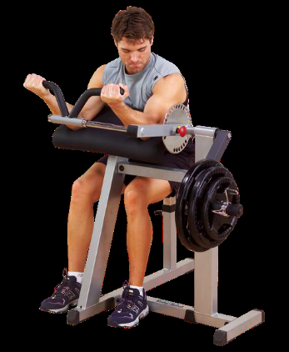
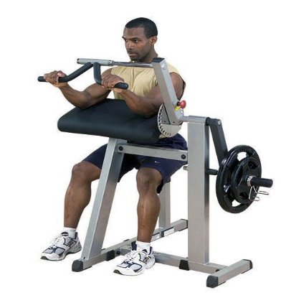
Analysis of bicep/tricep machine
Tricep/bicep is a bodybuilding machine that helps in building muscles and reduction of fats.
The machine has intelligent dual function design that assists in developing bulged biceps and triceps.
The machine improves upper and rear arm muscle’s fitness by speeding up time required to gain more muscular biceps and triceps.
It has two crucial muscles; the biceps on the anterior and the triceps on the posterior compartment
The diagrams below illustrate the operation of the machine

Slide 4
Analysis of triceps/biceps machine
The triceps part from the biceps provides very smooth changes to triceps exercise
This machine design allows for the alignment of the upper arm pad with the elbow.
It also provides alignment with the lifting arm’s rotational axis.
On the triceps/biceps machine, both the triceps and biceps muscles need to act against each other for the elbow joint to be bend or be straightened
For the elbow to bend, biceps need to contract.
On the contrary, the triceps need to relax.
Common materials used by manufacturers to make the body of the machine include, iron, aluminum, stainless steel, carbon steel, copper, wood, and titanium.
For comfort purposes, the machine seat and handle are made from sponge.

Slide 5
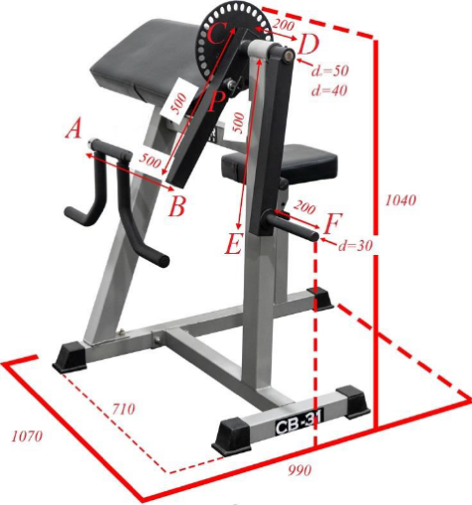
Problem definition
To explore a bodybuilding machine in our project: the bicep/triceps machine.
The 3d model of the arm will be designed with solid work software.
This will then enable us to calculate the maximum stress on the arm and the machine's deflection factor of safety
The maximum forces that can be applied to the handles of the device will also be established.
We shall also research on the most suitable materials for the arm of the machine.
Ultimately, we will then compare the solid work model's simulation results compared to the manual calculations.
Figure below shows the sketch of the arm

Slide 6
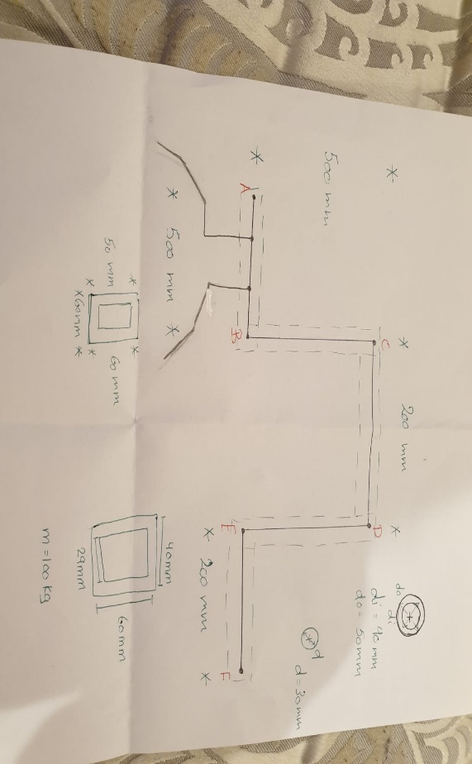
Calcalculations

Slide 7
I
Maximum Forces
If maximum mass of the individual is 140kg and gravity constant,
Weight=140*9.81=1373
The machine will only have one shear stress, maximum force =1373/1=1373
Notes:
Materials used
Following our intensive research, we established that the most appropriate material used in manufacturing this machine is Carbon steel 1020. This is because of carbon's role in the carbon steels' machinability, including hardness, tensile and yield strength, ability to be welded, and ductility. Its applicability also gets enhanced due to their cold will be drawn or turned and polished finish properties. Due to its low carbon content, Carbon steel 1020 can be induction hardened. Cracking during treatment is rare. The material is cheap and safer, which formed the other reasons for the choice of the materials.

Slide 8
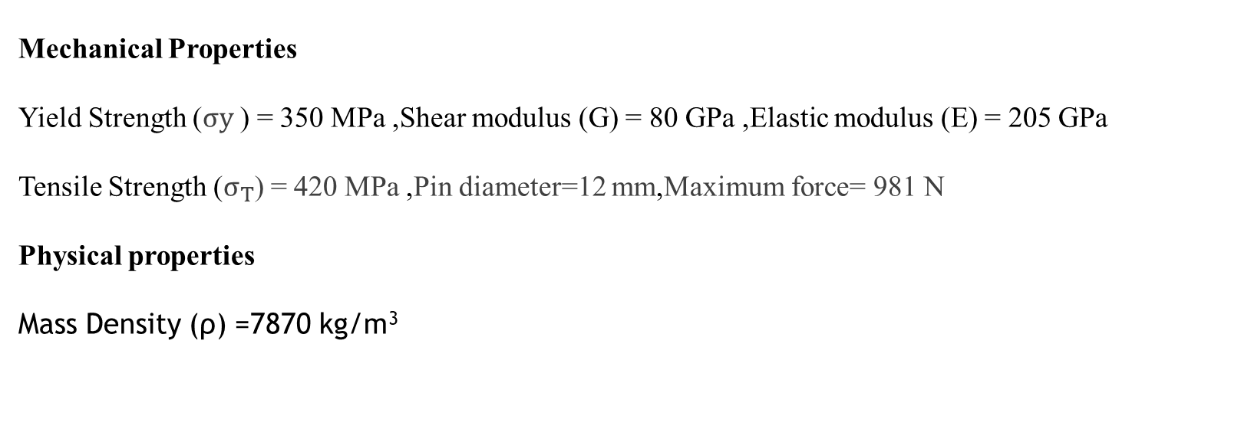
Work plan
The average normal stress due to axial loading will be first obtained.
The average shearing stress due to transverse loading, the maximum shearing stress due to the torsional load, and the maximum stresses due to the bending behaviour will then be calculated.
The maximum normal and shear stresses will then be calculated and later find the machine's safety factor. Ultimately, the deflection at A is calculated.
Mechanical Properties
Yield Strength ($σy$ ) = 350 MPa ,Shear modulus (G) = 80 GPa ,Elastic modulus (E) = 205 GPa
Tensile Strength ($σ_{T}$) = 420 MPa ,Pin diameter=12 mm,Maximum force= 981 N
Physical properties
Mass Density (ρ) =7870 kg/m³

Slide 9
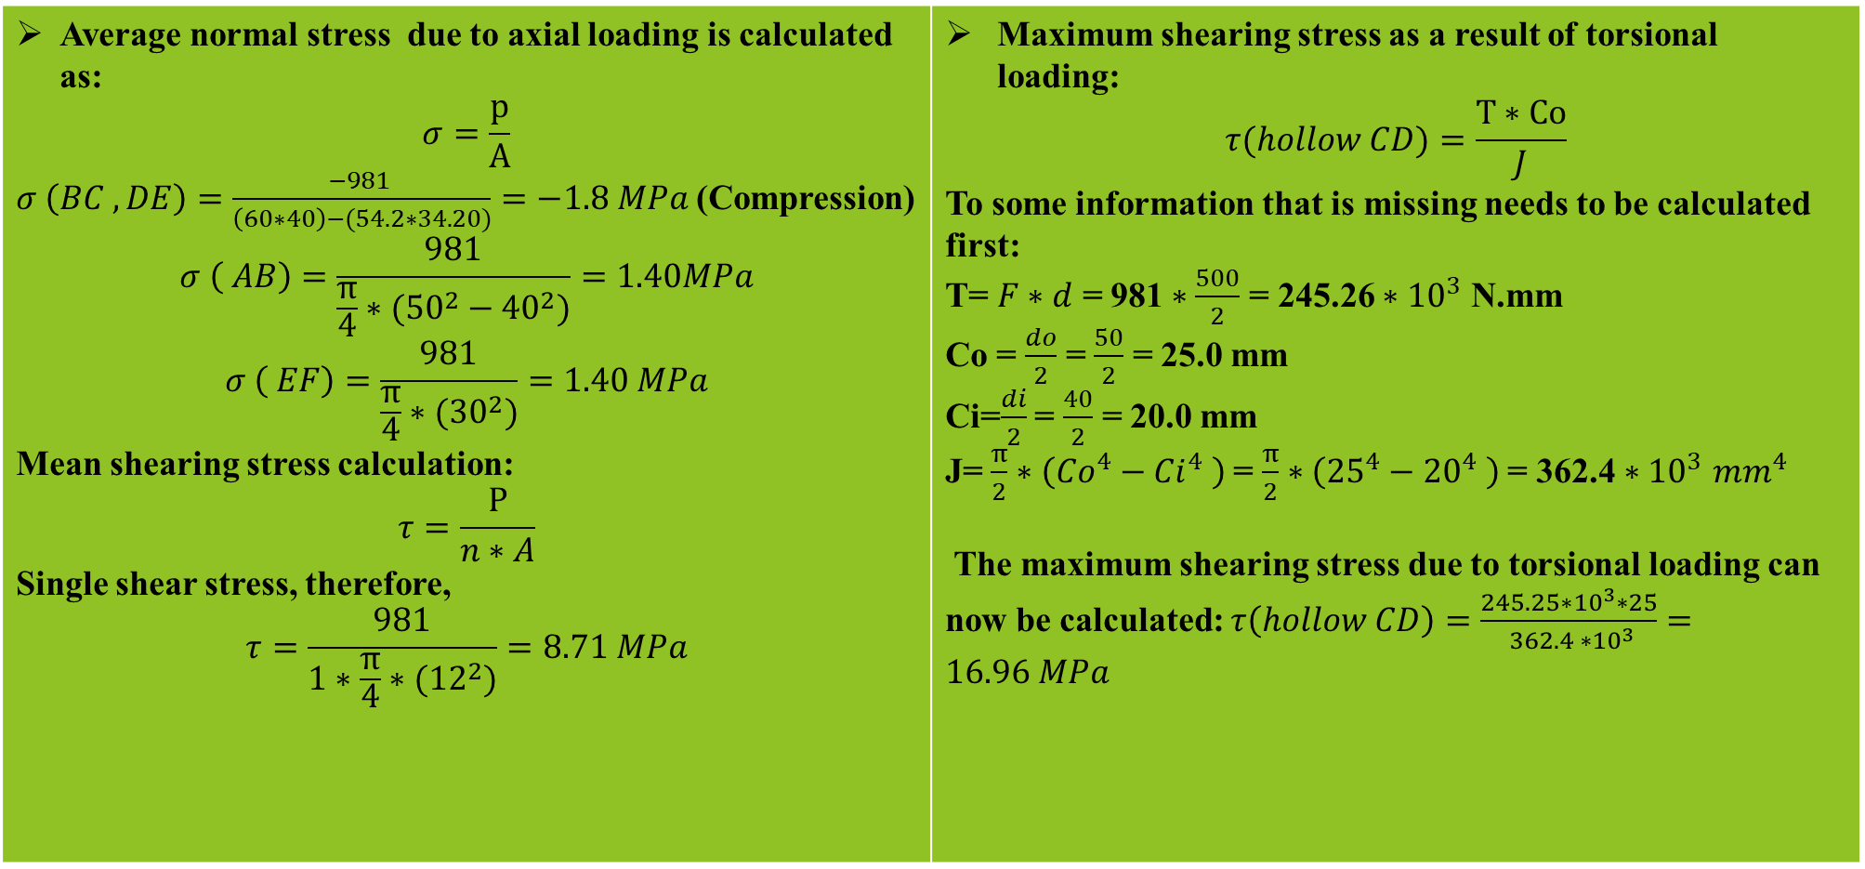
Calculations
Average normal stress due to axial loading is calculated as: $$σ=\frac{p}{A}$$ $σ \left(BC ,DE\right)=\frac{−981 }{\left(60∗40\right)−(54.2∗34.20)}=−1.8 MPa$ (Compression) $$σ \left( AB\right)=\frac{981}{\frac{π}{4}∗({50}^{2}−{40}^{2})}=1.40MPa$$ $$σ \left( EF\right)=\frac{981}{\frac{π}{4}∗({30}^{2})}=1.40 MPa$$ Mean shearing stress calculation: $$τ=\frac{P}{n∗A}$$ Single shear stress, therefore, $$τ=\frac{981}{1∗\frac{π}{4}∗({12}^{2})}=8.71 MPa$$ | Maximum shearing stress as a result of torsional loading: $$τ(hollow CD)=\frac{T∗Co}{J}$$ To some information that is missing needs to be calculated first: T= $F∗d$ = 981 $∗\frac{500}{2}$ = 245.26 $∗{10}^{3}$ N.mm Co = $\frac{do}{2}$ = $\frac{50}{2}$ = 25.0 mm Ci=$\frac{di}{2}$ = $\frac{40}{2}$ = 20.0 mm J= $\frac{π}{2}∗\left({Co}^{4}−{Ci}^{4} \right)$= $\frac{π}{2}∗\left({25}^{4}−{20}^{4} \right)$= 362.4 $∗{10}^{3}$ ${mm}^{4}$ The maximum shearing stress due to torsional loading can now be calculated: $τ\left(hollow CD\right)=\frac{245.25∗{10}^{3}∗25}{ 362.4 ∗{10}^{3}}=16.96 MPa$

Slide 10
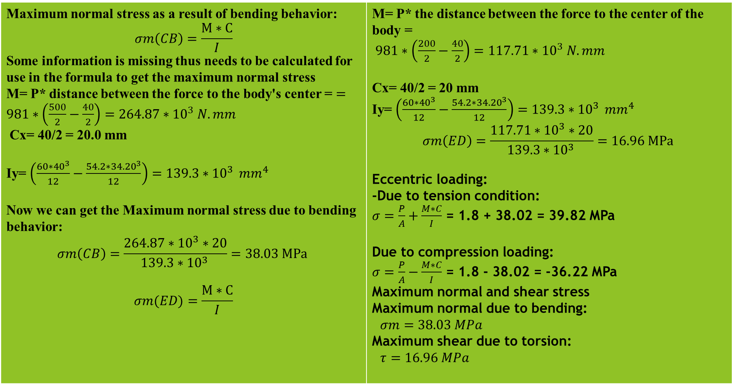
Calculations
Maximum normal stress as a result of bending behavior: $$σm\left(CB\right)=\frac{M∗C}{I}$$ Some information is missing thus needs to be calculated for use in the formula to get the maximum normal stress M= P* distance between the force to the body's center = $=981∗\left(\frac{500}{2}−\frac{40}{2}\right)=264.87∗{10}^{3} N.mm$ Cx= 40/2 = 20.0 mm Iy= $\left(\frac{60∗{40}^{3}}{12}−\frac{54.2∗{34.20}^{3}}{12}\right)=139.3∗{10}^{3 } mm^{4}$ Now we can get the Maximum normal stress due to bending behavior: $$σm\left(CB\right)=\frac{264.87∗{10}^{3}∗20}{139.3∗{10}^{3 }}=38.03 MPa$$ $$σm(ED)=\frac{M∗C}{I}$$ | M= P* the distance between the force to the center of the body = $981∗\left(\frac{200}{2}−\frac{40}{2}\right)=117.71∗{10}^{3} N.mm$ Cx= 40/2 = 20 mm Iy= $\left(\frac{60∗{40}^{3}}{12}−\frac{54.2∗{34.20}^{3}}{12}\right)=139.3∗{10}^{3 } mm^{4}$ $$σm\left(ED\right)=\frac{117.71∗{10}^{3}∗20}{139.3∗{10}^{3 }}=16.96 MPa$$ Eccentric loading: -Due to tension condition: $σ=\frac{P}{A}+\frac{M∗C}{I}$ = 1.8 + 38.02 = 39.82 MPa Due to compression loading: $σ=\frac{P}{A}−\frac{M∗C}{I}$ = 1.8 - 38.02 = -36.22 MPa Maximum normal and shear stress Maximum normal due to bending: $σm=38.03 MPa$ Maximum shear due to torsion: $τ=16.96 MPa$

Slide 11
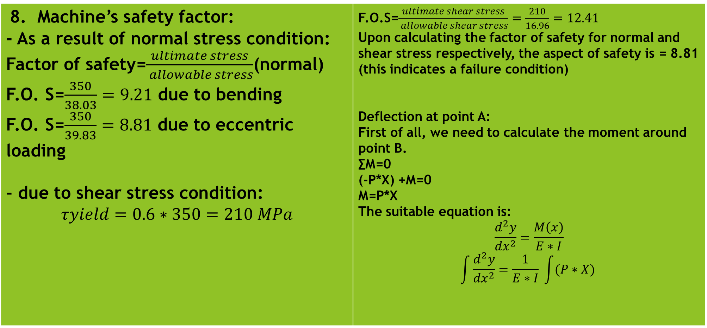
Calculations
8. Machine’s safety factor: - As a result of normal stress condition: Factor of safety=$\frac{ultimate stress}{ allowable stress}$(normal) F.O. S=$\frac{350}{38.03}=9.21$ due to bending F.O. S=$\frac{350}{39.83}=8.81$ due to eccentric loading - due to shear stress condition: $$τyield=0.6∗350=210 MPa$$ | F.O.S=$\frac{ultimate shear stress}{ allowable shear stress}=\frac{210}{16.96}=12.41$ Upon calculating the factor of safety for normal and shear stress respectively, the aspect of safety is = 8.81 (this indicates a failure condition) Deflection at point A: First of all, we need to calculate the moment around point B. ∑M=0 (-P*X) +M=0 M=P*X The suitable equation is: $$\frac{d^{2}y}{dx^{2}}=\frac{M\left(x\right)}{E∗I}$$ $$\int{\frac{d^{2}y}{dx^{2}}=\frac{1}{E∗I} \int{(P∗X)}}$$

Slide 12
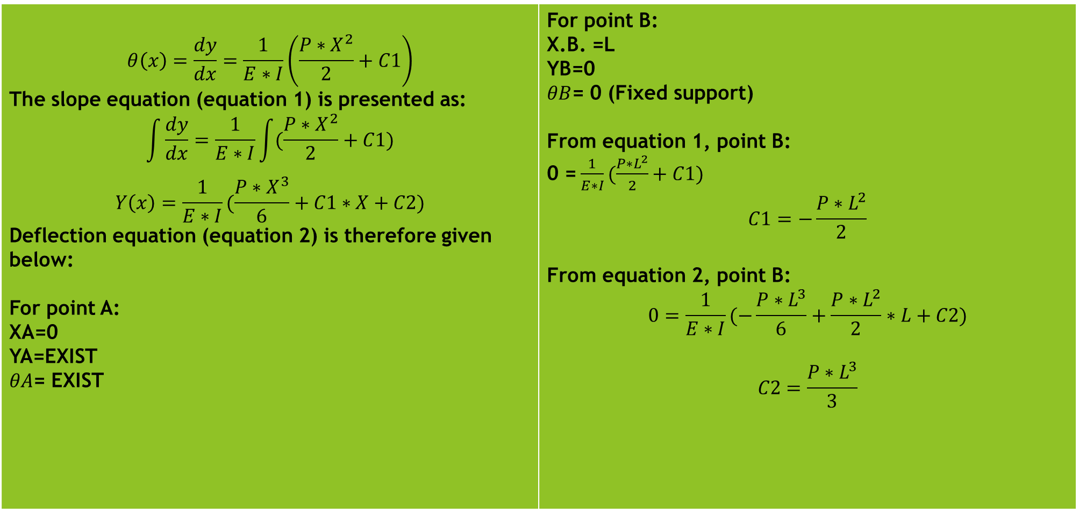
Calculations
$$θ\left(x\right)=\frac{dy}{dx}=\frac{1}{E∗I}\left(\frac{P∗X^{2}}{2}+C1\right)$$ The slope equation (equation 1) is presented as: $$\int{\frac{dy}{dx}}=\frac{1}{E∗I}\int{(\frac{P∗X^{2}}{2}+C1)}$$ $$Y\left(x\right)=\frac{1}{E∗I}(\frac{P∗X^{3}}{6}+C1∗X+C2)$$ Deflection equation (equation 2) is therefore given below: For point A: XA=0 YA=EXIST $θA$= EXIST | For point B: X.B. =L YB=0 $θB$= 0 (Fixed support) From equation 1, point B: 0 =$\frac{1}{E∗I}(\frac{P∗L^{2}}{2}+C1)$ $$C1=−\frac{P∗L^{2}}{2}$$ From equation 2, point B: $$0=\frac{1}{E∗I}(−\frac{P∗L^{3}}{6}+\frac{P∗L^{2}}{2}∗L+C2)$$ $$C2=\frac{P∗L^{3}}{3}$$

Slide 13
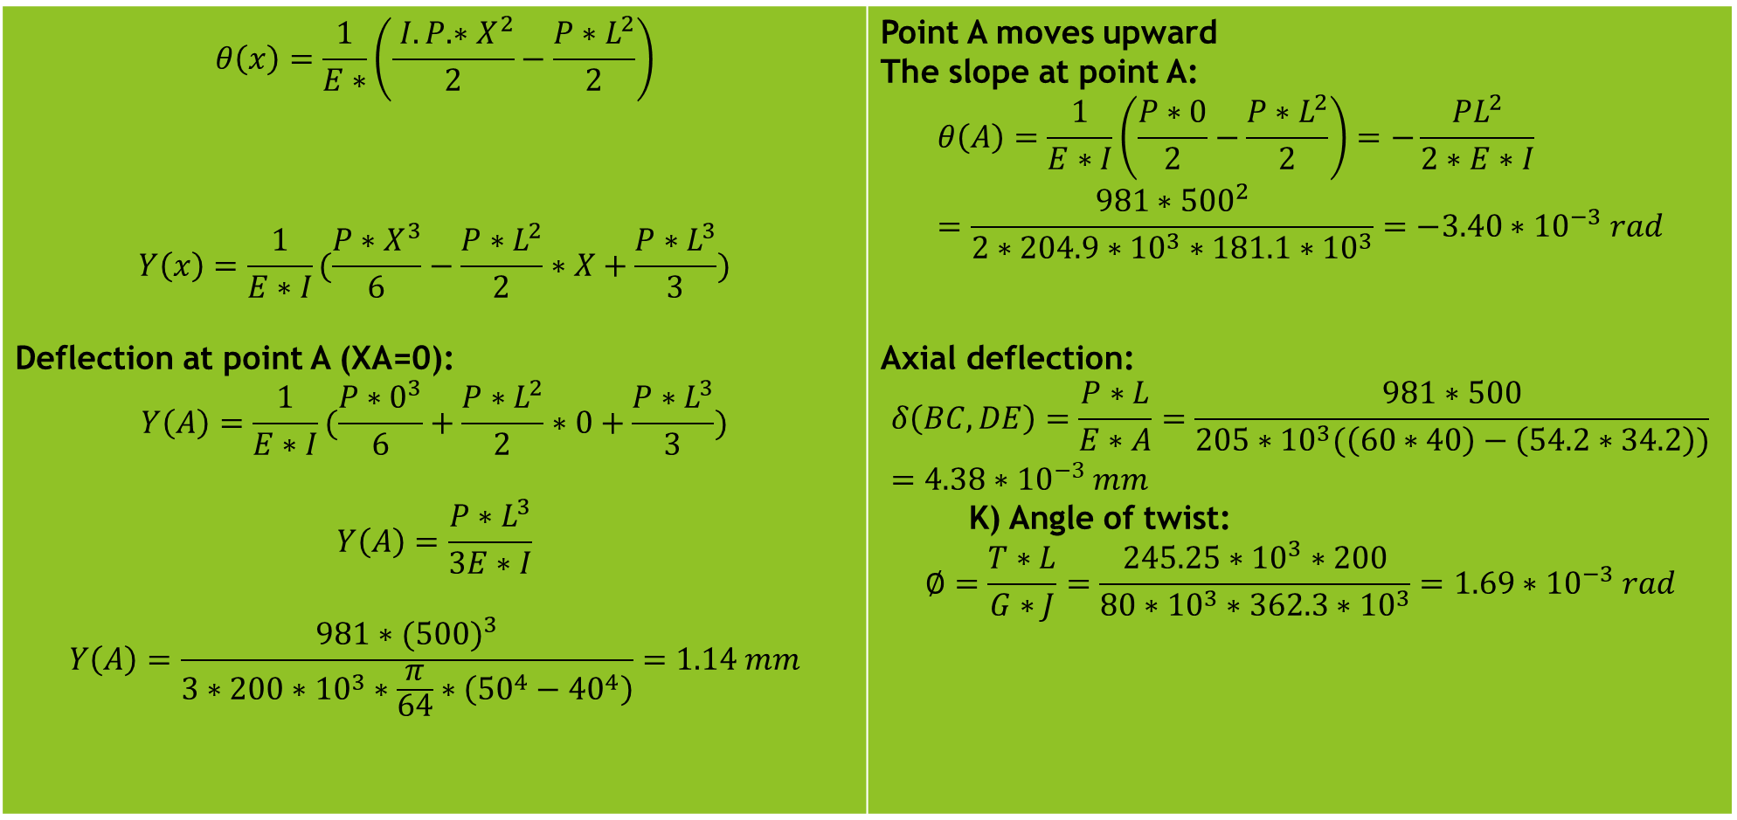
Calculations
$$θ\left(x\right)=\frac{1}{E∗}\left(\frac{ I.P.∗X^{2}}{2}−\frac{P∗L^{2}}{2}\right)$$ $$Y\left(x\right)=\frac{1}{E∗I}(\frac{P∗X^{3}}{6}−\frac{P∗L^{2}}{2}∗X+\frac{P∗L^{3}}{3})$$ Deflection at point A (XA=0): $$Y\left(A\right)=\frac{1}{E∗I}(\frac{P∗0^{3}}{6}+\frac{P∗L^{2}}{2}∗0+\frac{P∗L^{3}}{3})$$ $$Y\left(A\right)=\frac{P∗L^{3}}{3E∗I}$$ $$Y\left(A\right)=\frac{981∗({500)}^{3}}{3∗200∗{10}^{3}∗\frac{π}{64}∗\left({50}^{4}−{40}^{4}\right)}=1.14 mm$$ | Point A moves upward The slope at point A: $$θ\left(A\right)=\frac{1}{E∗I}\left(\frac{P∗0}{2}−\frac{P∗L^{2}}{2}\right)=−\frac{PL^{2}}{2∗E∗I}=\frac{981∗{500}^{2}}{2∗204.9∗{10}^{3}∗181.1∗{10}^{3}}=−3.40∗{10}^{−3} rad$$ Axial deflection: $$δ\left(BC,DE\right)=\frac{P∗L}{E∗A}=\frac{981∗500}{205∗{10}^{3}(\left(60∗40\right)−\left(54.2∗34.2\right))}=4.38∗{10}^{−3} mm$$ K) Angle of twist: $$∅=\frac{T∗L}{G∗J}=\frac{245.25∗{10}^{3}∗200}{80∗{10}^{3}∗362.3∗{10}^{3}}=1.69∗{10}^{−3} rad$$

Slide 14
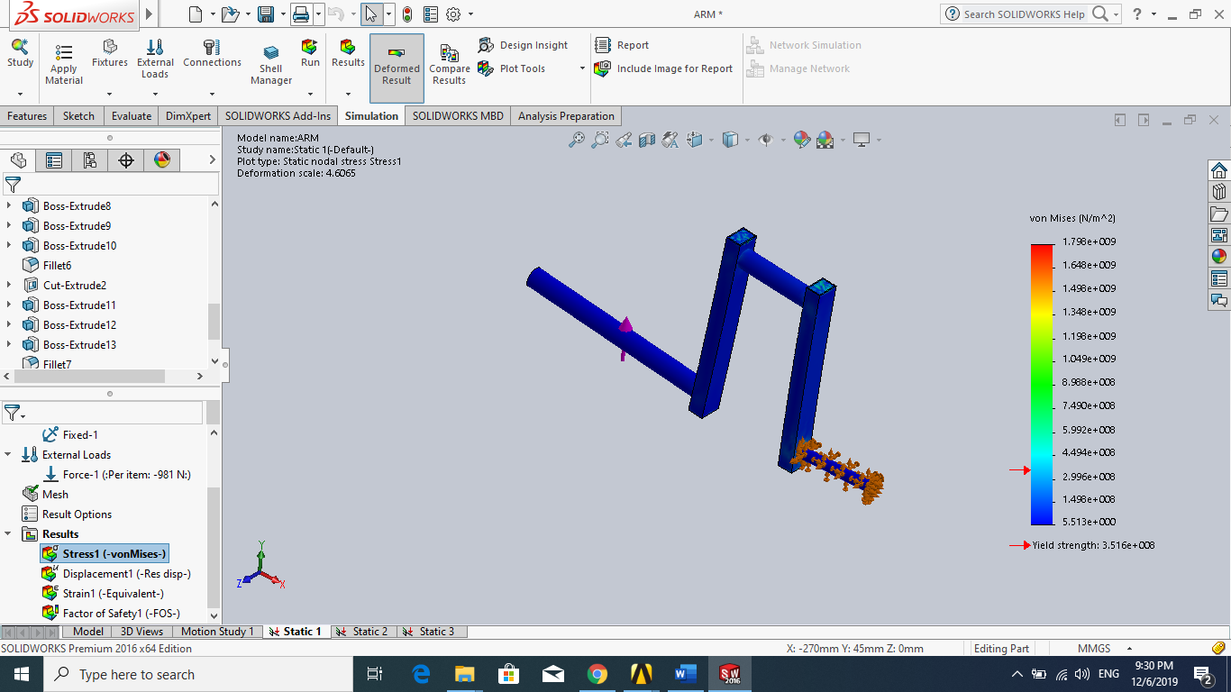

Solid work simulation
We used solid work software in creating the arm and apply maximum force to it. We ran The simulation, and obtained the following results:
maximum stress=$1.799∗{10}^{9}$

Slide 15
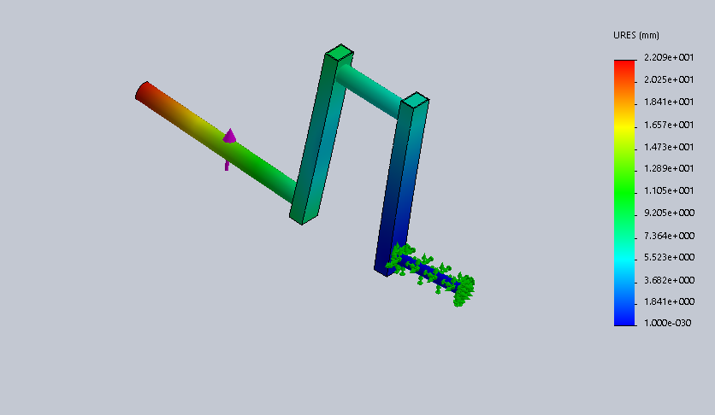
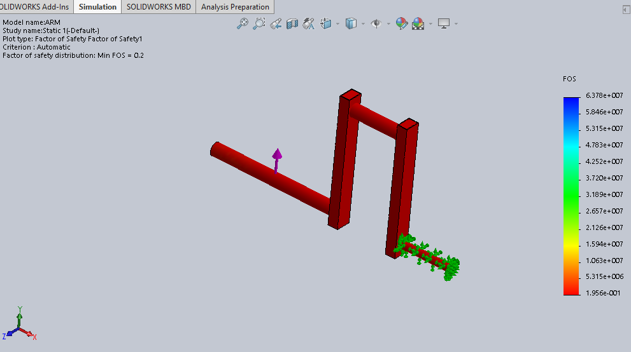
Solid work simulation
deflection factor of safety
simulation depicts that the factor of safety= 0.20. It is safe since it should be greater than 1 for a secure machine.
From the simulation using the software, we realized that the machine was not safe enough, and the results between hand calculation and the results of the software simulation were different.
We achieved the different results chiefly as the software was calculating von misses (3D, stresses). The hand calculations depend on plane stresses, but the solid work simulation software usually depends on 3D stresses. Therefore, the software’s accuracy is more than that of hand calculations. This is because the program usually takes the factor of the overall object.

Slide 16
Conclusion
The group was able to learn the mechanical behavior of the bicep/tricep machine as well as the best material for its manufacturing.
This was achieved by the use of a simple equation to depict how the maximum force can be achieved, also assumption of some dimensions and as well as the ones given, a solid work model was created, a discussion was then conducted about our plan of working for achieving the next deliverable, in what were thus our final results achieved when the total forces learned in the course are determined.

Slide 17
References
https://www.azom.com/article.aspx?ArticleID=6114

